Slide 1
CMPS 260 Project 3D Reconstruction
by Li Yunzhe

Slide 2
Overview
Input: two images taken from different angles(same size)
Output: a 3D model (.ply )
Tools: OpenCV and Python (Plan B: Matlab)
Li Yunzhe

Slide 3
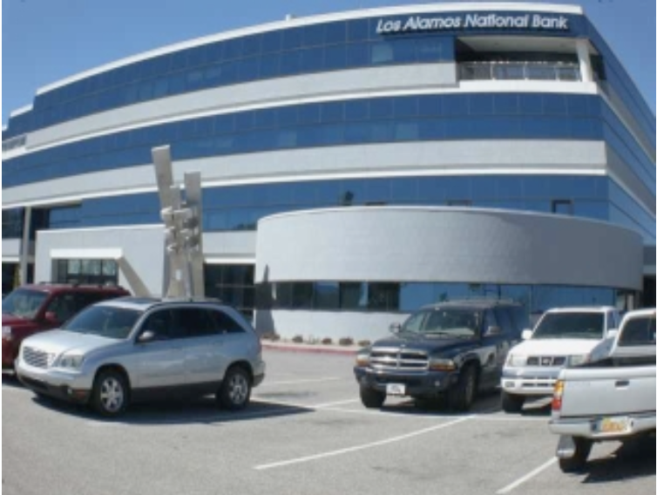
Camera Calibration (iPhone 6s)
Use the app Camera+ to lock the focus
Find the camera intrinsic matrix K (convert the pixel 2D coordinates to a line in real world 3D coordinates)
Find the distortion coefficient
http://docs.opencv.org/doc/tutorials/calib3d/camera_calibration/camera_ calibration.html. (a C++ camera calibration script, my Plan B)
Li Yunzhe

Slide 4
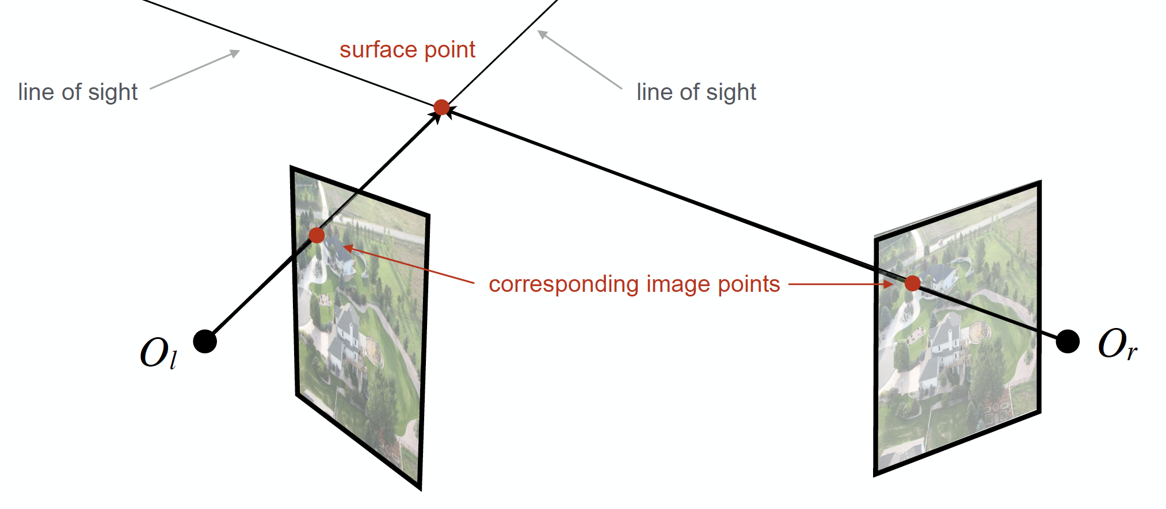
Matching
Camera K matrix cannot find the exact coordinates in 3D with one image
Algorithm: SURF (Speeded-Up Robust Features)
Li Yunzhe

Slide 5
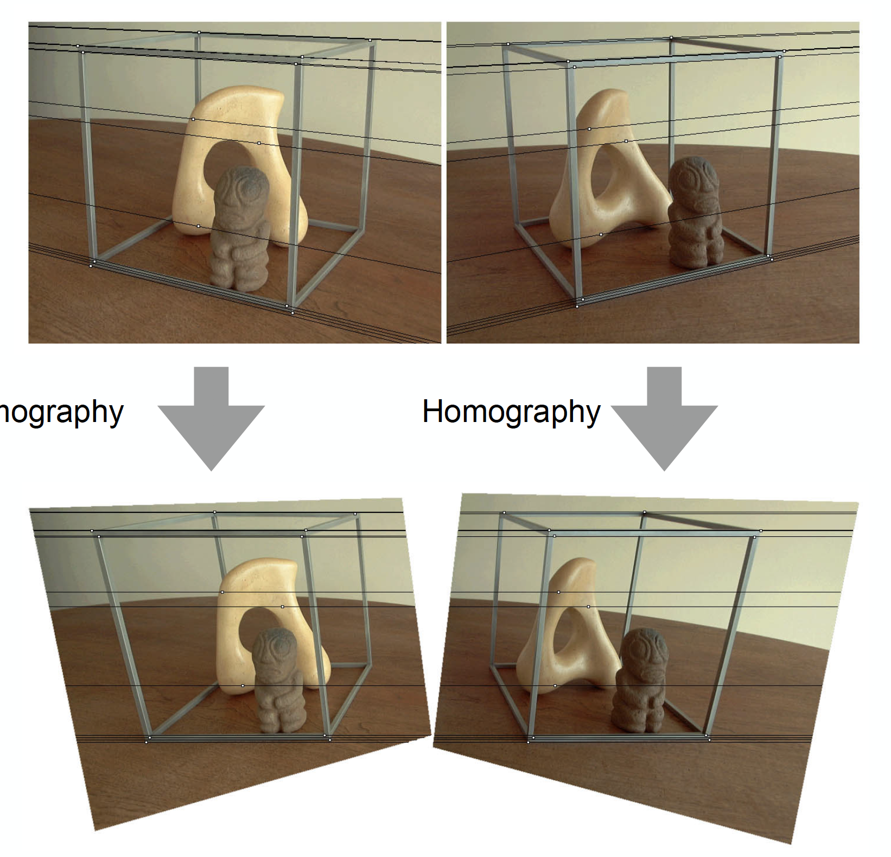
Image Rectification
Find the essential of the the camera when taking the second image (first image camera position is reference)
Will also use the feature matching
Li Yunzhe

Slide 6
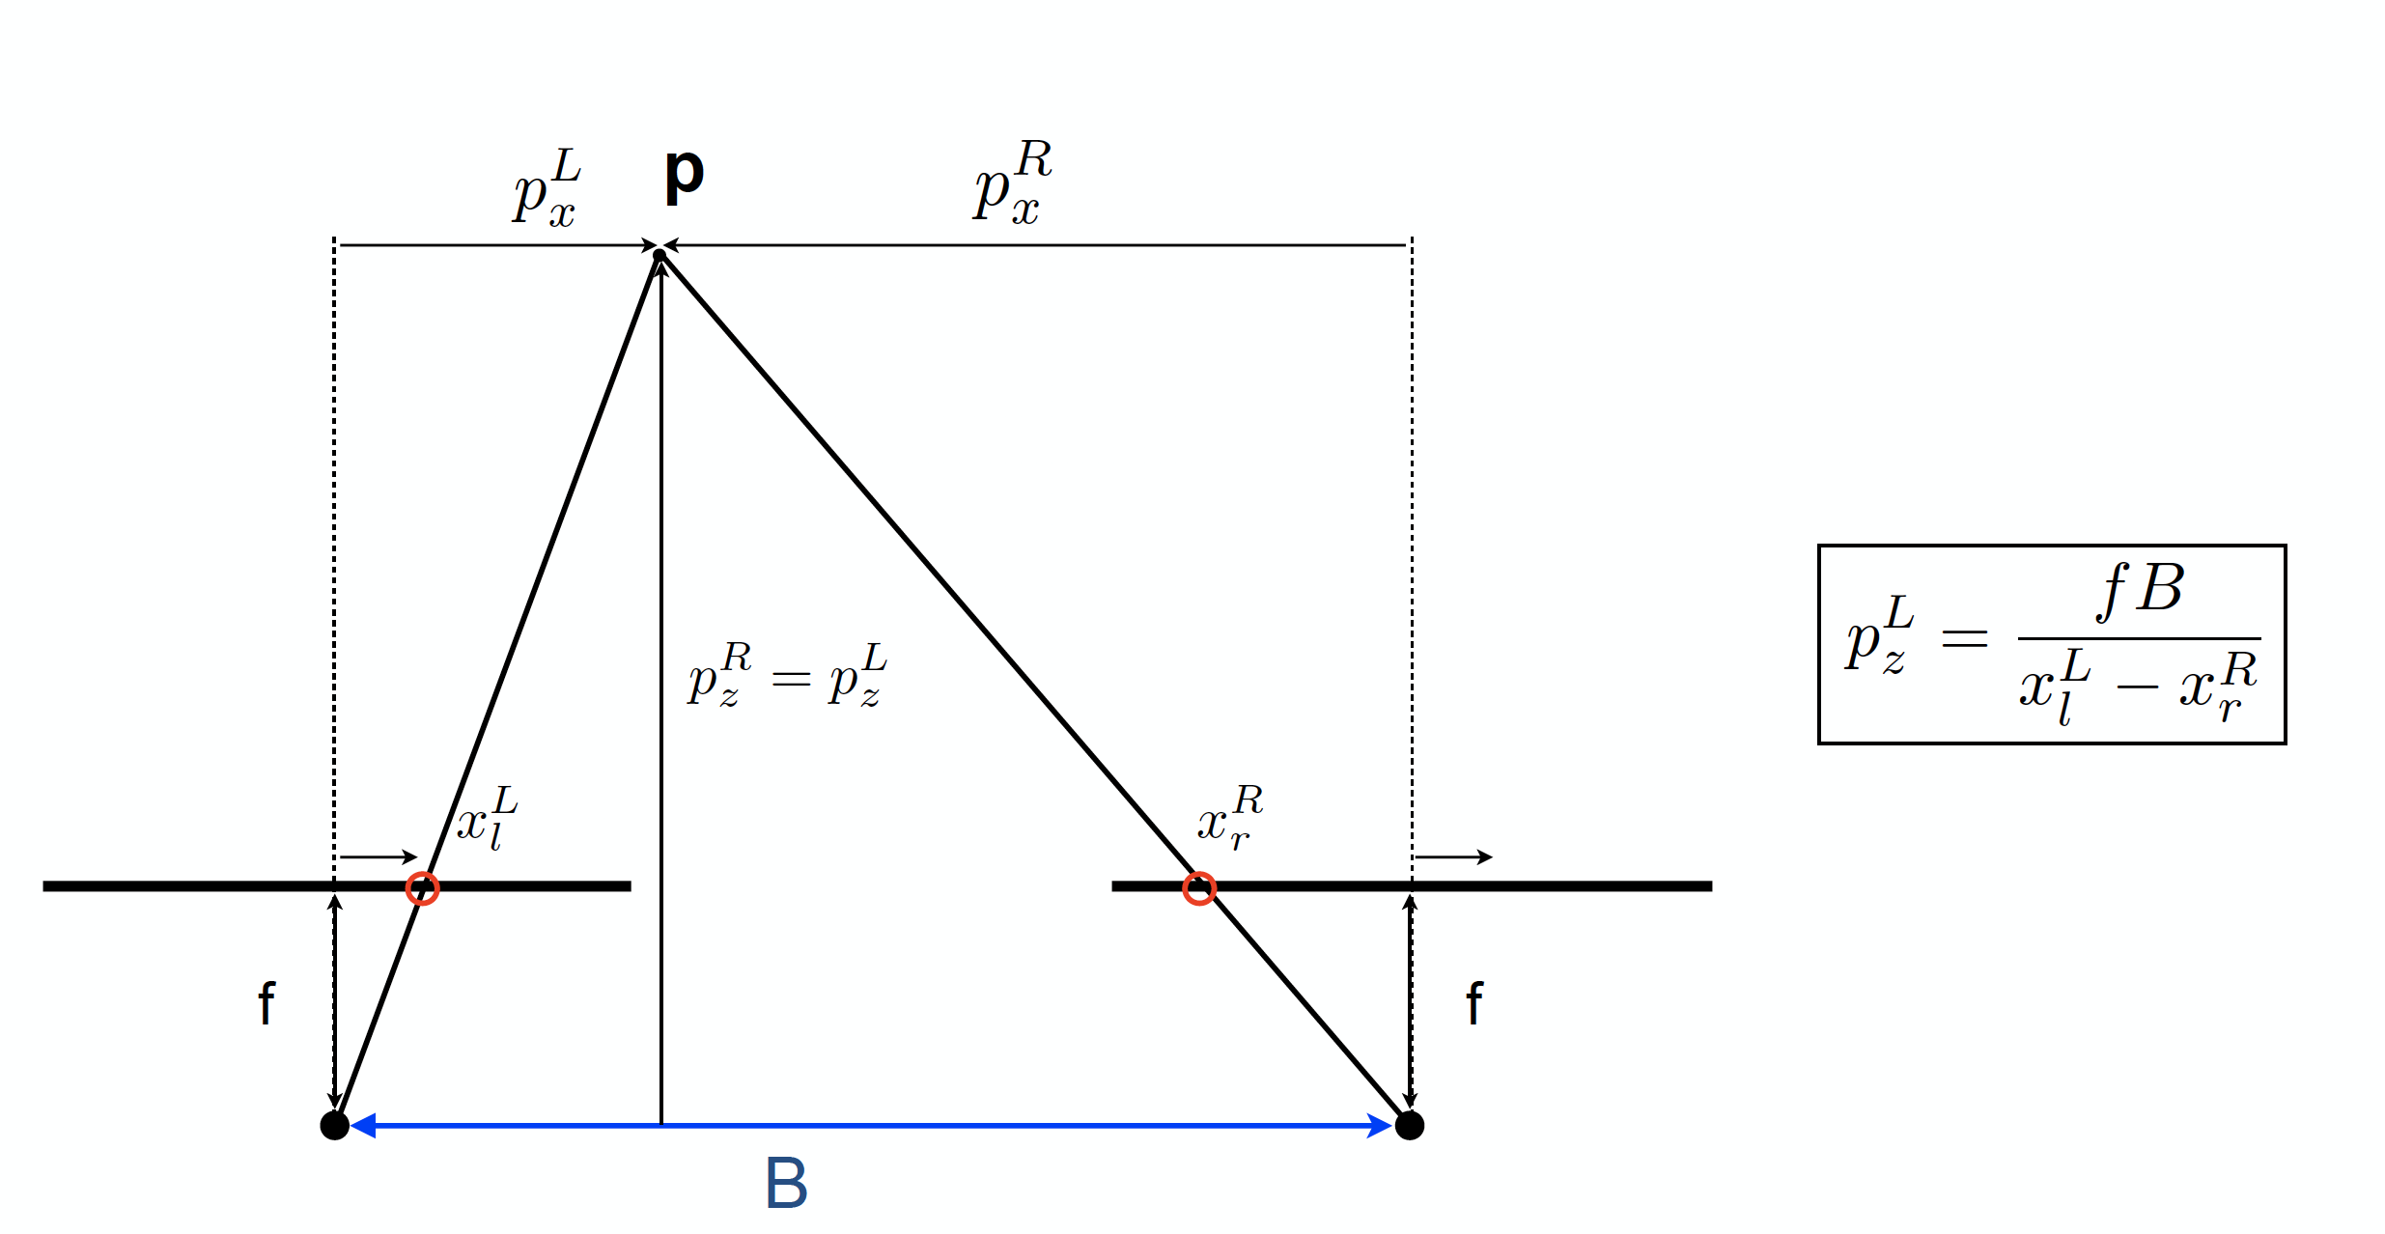
3D Reconstruction
Epipolar Geometry: get the 3D coordinates
Li Yunzhe

Slide 7
Comparison
Reconstruct the same model using Agisoft PhotoScan(a professional 3D scan tool), then compare to my model
Li Yunzhe

Slide 8
Problem
How to deal with 3 or more photos?
How to reduce the noise?

